Slide 1
Linux Network Configuration
Linux System Administration
/etc/resolv.conf Tells the kernel which name server should be queried when a program asks to "resolve" an IP Address.
nameserver 172.31.1.1
search cc.iitk.ac.in iitk.ac.in
/etc/sysconfig/network Indicates networking is enabled (NETWORKING=yes) and provides information on hostname, gateway and nis domain.
NETWORKING=yes
HOSTNAME=webhome.cc.iitk.ac.in
NISDOMAIN=cc
GATEWAY=172.31.1.250

Slide 2
Linux Network Configuration
Linux System Administration
/etc/sysconfig/network-scripts/ifcfg-eth0 Network configurations like boot protocol (static/dhcp), ip address, netmask, network address, broadcast address etc.
    DEVICE=eth0
    ONBOOT=yes
    BOOTPROTO=static
    IPADDR=172.31.1.40
    NETMASK=255.255.0.0
    BROADCAST=172.31.255.255
    NETWORK=172.31.0.0
    GATEWAY=172.31.1.250

Slide 3
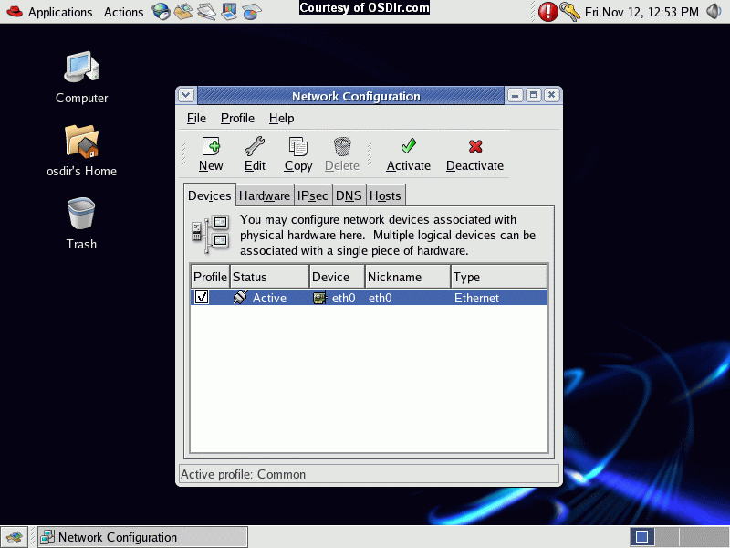

Slide 4
Scheduling Jobs: Cron
Linux System Administration
Cron is a program that enables you to execute a command, or a script with a sequence of commands, at a specified date, time or at set intervals.
Add the job script in /etc/cron.hourly or /etc/cron.daily or /etc/cron.weekly or /etc/cron.monthly to schedule a job

Slide 5
Scheduling Jobs: Cron
Linux System Administration
Make an entry in /etc/crontab file to schedule a job (crontab -e) the format is
* * * * * command_to_execute
each star denotes Minute Hour Day_of_Month Month Day_of_Week
Minute = Minute of the hour, 00 to 59. * Will indicate every minute
Hour = Hour of the day in 24-hour format, 00 to 23. * Will indicate
every hour
Day = Day of the month, 1 to 31. * Will indicate every day
Month = Month of the year, 1 to 12. * Will indicate every month
Day = Day of the week, 3 chars - sun, mon, tue, or numeric (0=sun, 1=mon etc).... * Will indicate every day
Task = The command you want to execute

Slide 6
Backup & Restore
Linux System Administration
Backup the user area or configuration file
Use tar to take backup on a different disk or tape
Backup can be scheduled using cron
Backup: tar –zcvf <tar filename> <Directory Tree to be backedup>
Restore: tar –zxvf <tar filename> <file to be recovered>
Backup should be occasionally checked by restoring it
Backup Policy: Full Backup every weekly/fortnightly and incremental backup every day

Slide 7
Adding & Removing Software
Linux System Administration
Download a binary
Download the source code and compile on the system (download, untar, configure, make, make install, make uninstall)
Use RPM - Redhat Package Manager and install rpms
www.rpmseek.com & www.rpmfind.net can be used to search and download rpms (i386 Binary RPMs or SRC RPMs)
For Binary rpms: rpm [options] rpm-file
(rpm –qa, rpm –ivh, rpm –Uvh, rpm -e)
Where -q= query, -a= all, -i=install, -v=verbrose, -U= upgrade, -h= hash, -e= erase
For Source rpms: rpmbuild –rebuild rpm-source-file
Compiled binary rpms will be available at /usr/src/redhat/RPMS/i386 which can be installed

